Slide 1

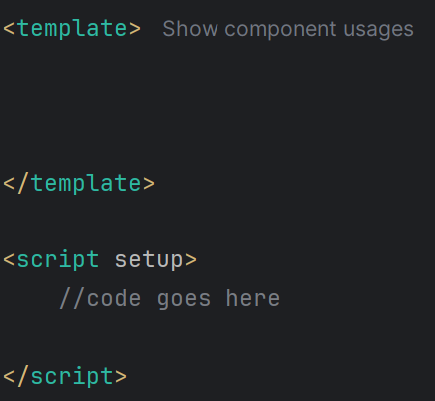


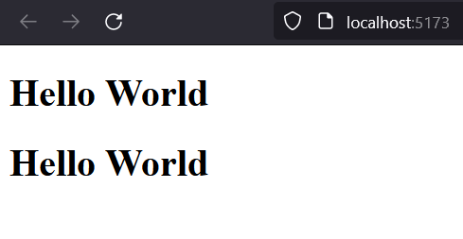
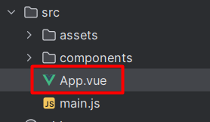
Progressive
Text Interpolation
Vue 3
Template Syntax
{{
}}
Text Interpolation
Raw HTML
`Mustache` Syntax
Attribute Binding
Multiple Attr Binding
Boolean Attributes
JavaScript Expression
Output
Directives
Arguments
@Programing with Rakib

Slide 2

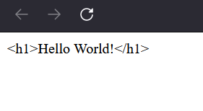

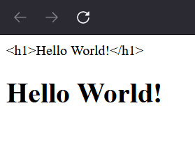
Progressive
Raw HTML
Vue 3
Output
Template Syntax
Text Interpolation
Raw HTML
Attribute Binding
Multiple Attr Binding
Boolean Attributes
v-html
JavaScript Expression
Directives
`html` directive
Arguments
@Programing with Rakib

Slide 3
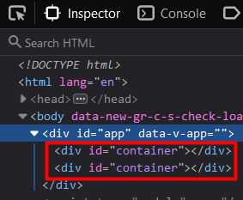
Progressive
Attribute Binding
Vue 3
Output
Template Syntax
Text Interpolation
Raw HTML
Shorthand for `v-bind`
Attribute Binding
Multiple Attr Binding
Boolean Attributes
v-bind
JavaScript Expression
Directives
`Attribute binding` directive
Arguments
@Programing with Rakib

Slide 4
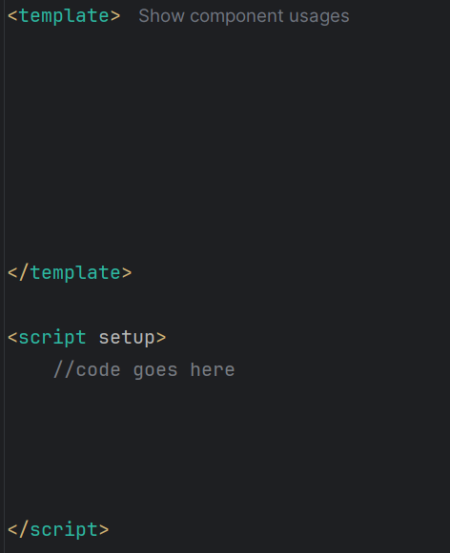
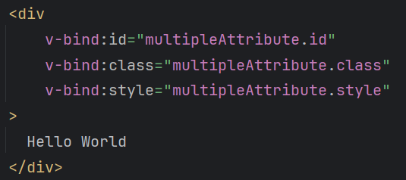
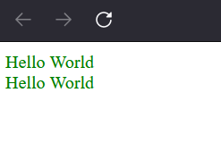
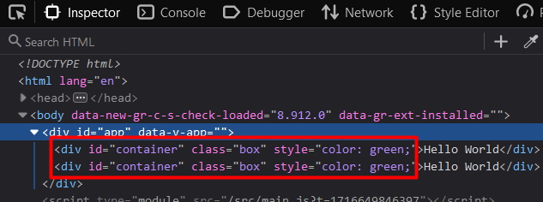

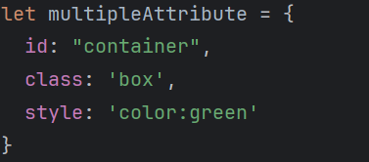
Progressive
Attribute Binding
Vue 3
Output
Template Syntax
Text Interpolation
Raw HTML
Attribute Binding
Multiple Attr Binding
Boolean Attributes
JavaScript Expression
v-bind=“object”
Directives
Multiple attribute binding
Arguments
@Programing with Rakib

Slide 5
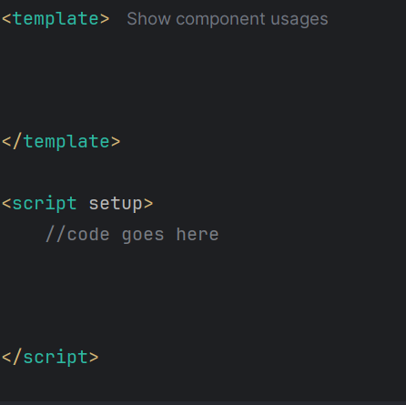

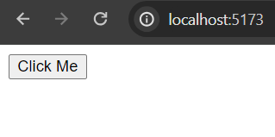
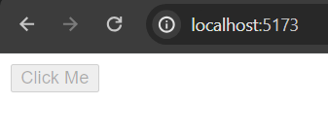
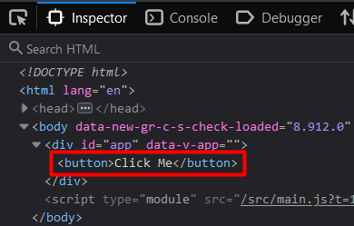
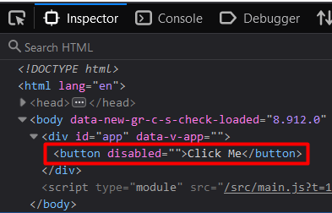


Progressive
Boolean Attribute
Vue 3
Output
Template Syntax
Text Interpolation
Raw HTML
Attribute Binding
Multiple Attr Binding
Boolean Attributes
JavaScript Expression
Directives
Arguments
@Programing with Rakib

Slide 6
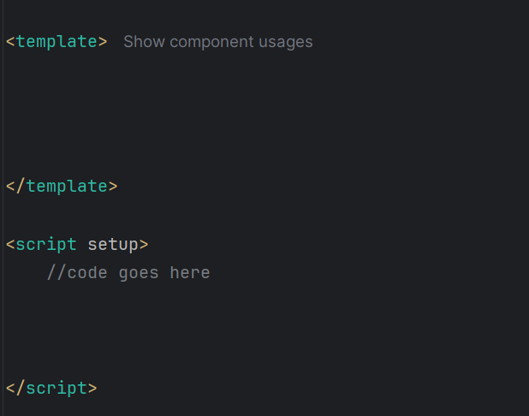
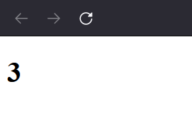
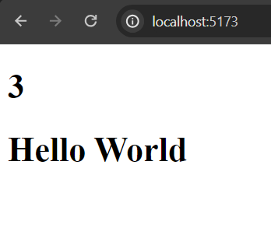

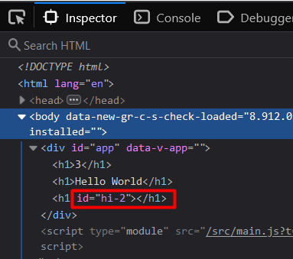

Progressive
Attribute Binding
Vue 3
Output
Template Syntax
Text Interpolation
Raw HTML
Attribute Binding
Multiple Attr Binding
Boolean Attributes
JavaScript Expression
Directives
Arguments
@Programing with Rakib

Slide 7
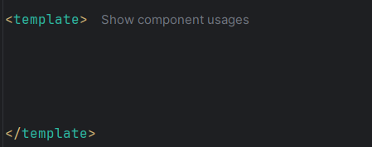
Progressive
Directives
Vue 3
Directive হচ্ছে vue js এ একধরনের special attribute যা v- দ্বারা যুক্ত হয়। vue js এ নির্দিষ্ট কয়েকটি directive
আছে। এগুলো element এ attribute এর মতই লিখতে হয়। যেমনঃ
v-if
v-else-if
v-else
v-bind
v-html
v-on
v-slot
v-text
v-show
v-model
v-pre
v-once
v-memo
v-cloak
v-for
Template Syntax
Text Interpolation
Raw HTML
Attribute Binding
Multiple Attr Binding
Boolean Attributes
JavaScript Expression
Directives
Arguments
@Programing with Rakib

